Slide 1
Don’t Get Your Environment in a Twist!
Database release process to keep the systems all working with minimal impact
Steve Peterson
Senior Database Administrator, Team Lead, Photographer

Slide 2

















Thanks to our Sponsors!
Yearly Partners
Gold Sponsors

Slide 3
Leaning objectives
Understand what is needed for a database release.
Optimized agile (iterative) deployment.
Reduce risk of failure to production application releases that have database components.
Notes:
What is the breakdown of the room (DBA, Architect, Developer)?
Are you using agile?

Slide 4
What is a Database?
An organized collection of data.
A collection of objects
Schemas, Tables, Views, Stored Procedures, Queries
How do we (Humans) interact with the database?
DDL (Data Definition Language)
Create and modify structures, views, sprocs
DML (Data Manipulation Language)
Retrieve, Store, Modify data
DCL (Data Control Language)
Create roles, permissions and referential integrity
Notes:
We need to make sure we have the same nomenclature.

Slide 5
Standards & Best Practices
Why standards matter?
How the standards came to be?
How to enforce standards?
Notes:
Safety and reliability – ensure safety, reliability and environmental care.
Support for policies and regulations (HIPAA [Health Insurance Portability Accountability Act], PHI [Protected Health Information], PCI [Payment Card Industry]) – protecting user and business interests. Audits.
Interoperability – the ability of devices or teams to work together.
Business Benefits - Standardization provides a solid foundation upon which we build our business and encourages innovation

Slide 6
Database T-SQL Standards check list:
Here is a list of the most common staging release request issues:
Please discuss all new or alter of table structures with the DBA team and/or Architect for approval before development.
Triggers on core tables need to be discussed with the DBA team for approval before development/deployment.
Existing stored procedures that are altered will need to be brought up to the T-SQL Standards to be released.
Altering table(s) scripts should not have the data change and table change in the same script.

Slide 7
Database T-SQL Standards check list (cont):
All Stored Procedures should have the following:
USE [DatabaseName] clause at the top
All scripts/procedures/functions/TVPs should have this!
BEGIN at the beginning of the procedure and END at the end of the procedure.
SET XACT_ABORT, NOCOUNT ON;
SET TRANSACTION ISOLATION LEVEL READ UNCOMMITTED;
All objects (tables, views, functions, etc.) must be schema qualified even in in dbo schema.
No Database reference should be made within the stored procedure outside of the USE [Database] unless it is an object that lives outside of the database the stored procedure is in.
All Updates should have a where clause as to avoid updating entire table.
Notes should be included after the END (if you want to add comments)
NO SELECT *
For more detailed T-SQL standards, see the full T-SQL standards document.
Notes:
SET TRANSACTION ISOLATION LEVEL READ UNCOMMITTED;
This always brings up issues. If you want to see the dependencies go to the pdfs.

Slide 8
Release Needs
Storage or Repository (TFS)
Documentation of what needs to be released
List of changes
Type of change (DDL, DML, DCL)
Date the change was made
Who made the change
Scripts of the actual change
One script per object change (DDL)
One script per stored procedure (DDL)
One script per data manipulation (DML)
Permissions can be documented without a script (DCL)
Notes:
The list and the type of change can be included in the same “File/Object” or separated into the notes (e.g. “New Table”, “Altered Sproc”, etc)
The _Who made the change_ is pretty important, if there is an issue with the release it’s easier to contact the person that made the change to discuss the issue.

Slide 9
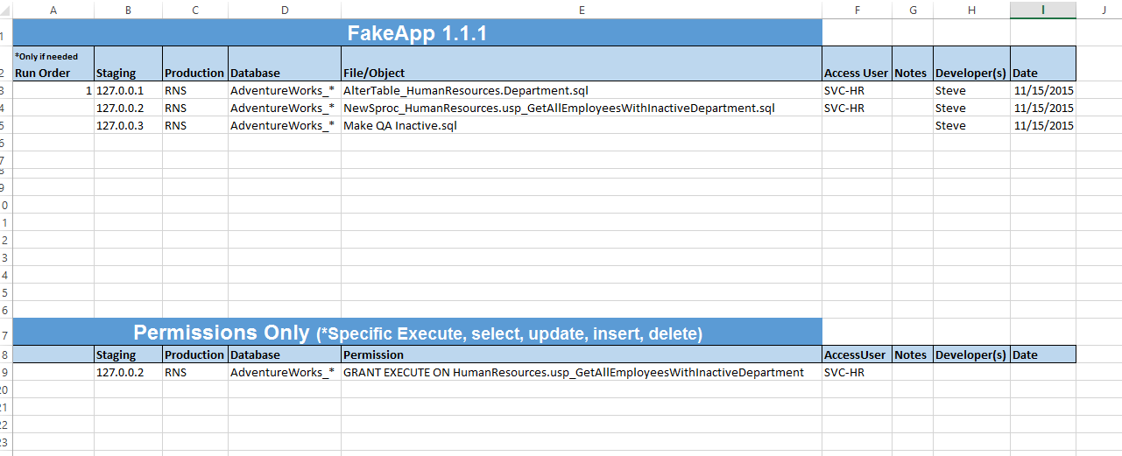
Database Release Documentation
Think of it like a play list of what needs to be pushed to production.

Slide 10
Procedure
Developers make changes in dev (☺)
Check-in to code repository (label)
Build database package (Release Engineer)
Get email or notification
Compare the spreadsheet and the code objects (they should match)
Deploy DDL, DML, DCL to staging if it meets standards
Deploy to production via comparison tool

Slide 11
demo

Slide 12
Questions and Discussions
Points to consider (learning objectives):
Understand what is needed for a database release.
Optimized agile (iterative) deployment.
Reduce risk of failure to production application releases that have database components.
Continuous Integration?
How do you do it?

Slide 13
Me
Steve Peterson
drblind@gmail.com
@SQLFitness – Twitter
LivePhotography – Instagram
FEED BACK PLEASE

